Slide 1

Velocify Titanium
A premium, secure, on‑demand logistics & fleet management system. Presented by Evan John, Donna George, Jowan Joe Mathew — February 20, 2026.

Slide 2

Executive Summary
Project Overview
End‑to‑end logistics ecosystem connecting Riders and Drivers via an admin‑verified web portal that enforces trust and operational rules.
Business Problem
Widespread distrust in unverified transport services and lack of enterprise tools for fleet governance, compliance, and visibility.
Solution Approach
"Gatekeeper" architecture — security and admin oversight embedded at every workflow boundary to prevent unauthorized access and ensure verified operations.
Expected Outcomes
High‑trust user environment, automated fleet workflows, faster driver onboarding, and measurable operational SLAs.

Slide 3
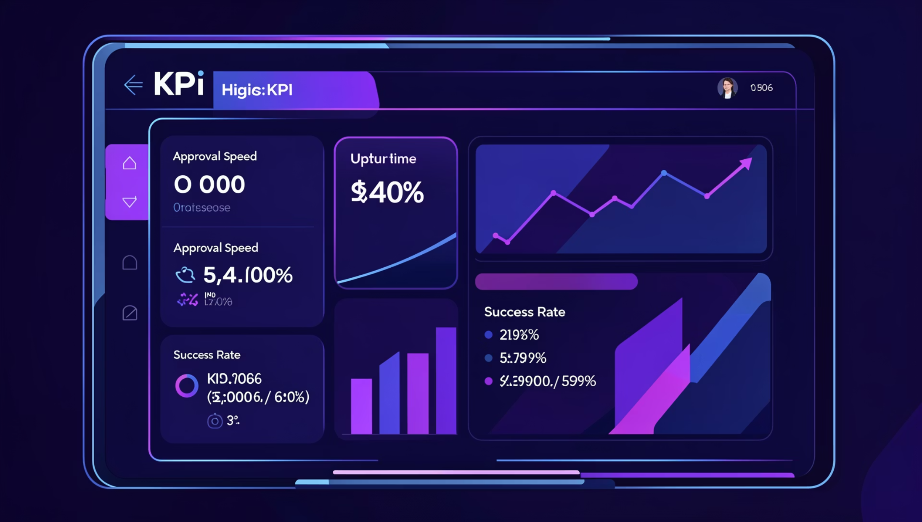
Business Objectives
Deliver a corporate‑grade transport platform with mandatory driver verification and enterprise controls.
Primary goal: Zero unauthorized driver access through enforced approval gates.
KPI focus: driver approval time, ride success rate, system uptime, SLA compliance.
Success criteria: flawless trip state transitions and traceable audit trails.
Strategic alignment: modernize logistics with enterprise security and premium UX standards.

Slide 4
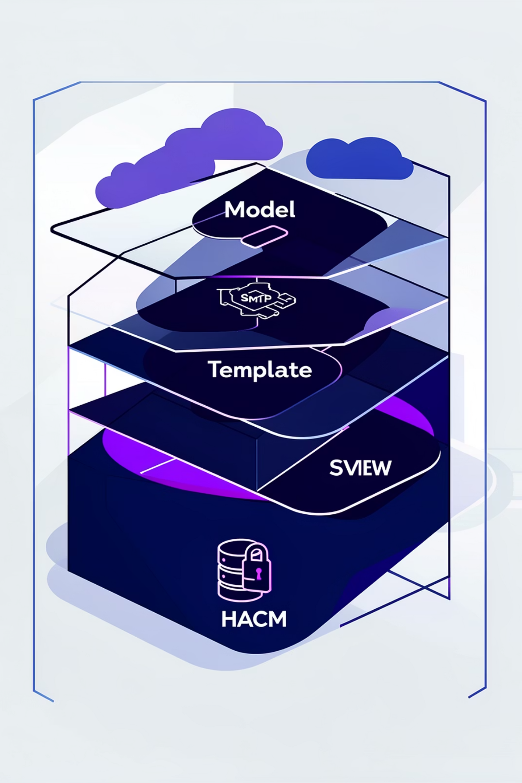




System Architecture
Clean MTV separation (Model‑Template‑View) for maintainability. Cloud‑ready deployment with secure integration points for notifications and recovery.
Core Stack
Python 3.13, Django 6.0 — stable, mature framework for rapid, secure development.
Data Layer
MySQL 8.0 with relational indexing tuned for high‑volume transactions and ACID consistency.
Security Integrations
HMAC tokens for secure recovery, SMTP for notifications, PBKDF2 password hashing, CSRF protection.
Deployment
Containerized, cloud‑staged environments for global reach, autoscaling, and DR planning.

Slide 5
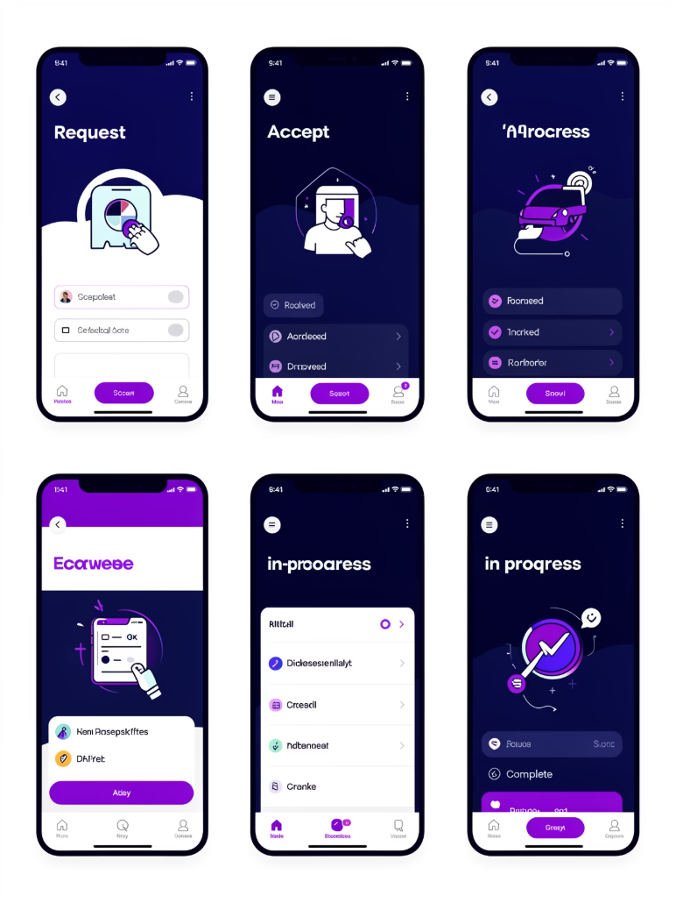
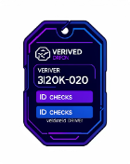

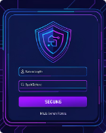
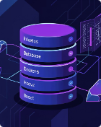
Key Features & Modules
Driver Verification
Five‑Stage Ride State Machine
Security & Compliance
Mandatory admin approval queue, identity checks, document validation, audit logs for each approval event.
PBKDF2 hashing, CSRF protection, session controls, encrypted storage for PII and auditability for audits.
Deterministic states (Request → Accept → Arrived → In‑Progress → Complete) with strict transition guards and rollback handling.
Scalability
Optimized relational indexing and query plans to support growing fleet, concurrent trips, and realtime updates.

Slide 6




Project Timeline
Foundation
Frontend
DB integration and infra setup
UX, admin portal and beta go‑live
Logic
State machine and admin approval gateway
Phases: Foundation (infra, DB), Logic Development (state machine, security), Frontend (UX, admin portal). Dependencies: Django‑MySQL bridge and reliable SMTP. Go‑live: cloud staging → beta → production.

Slide 7
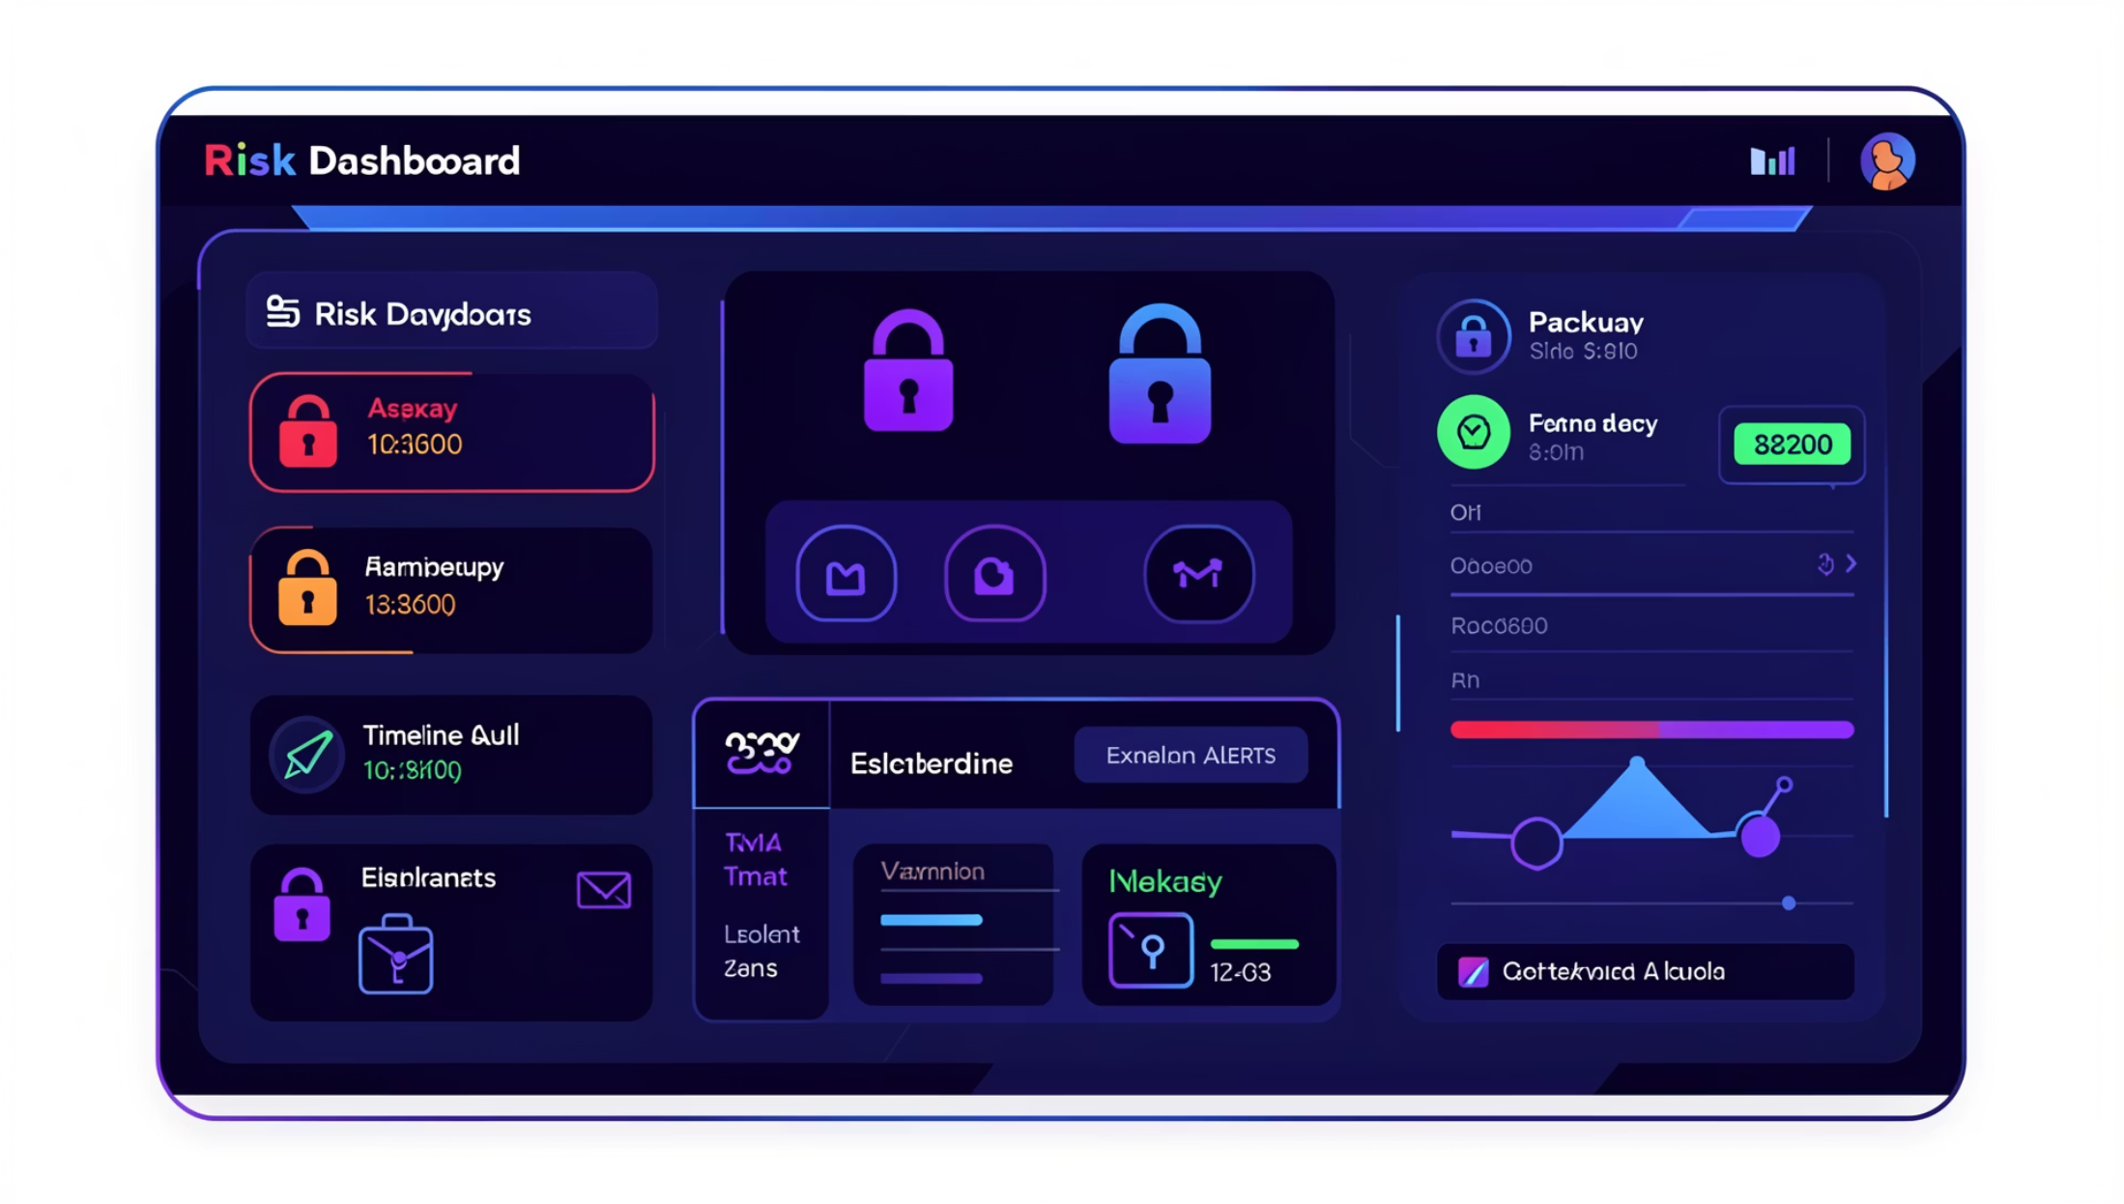
Risk Management
Identified risks: unauthorized dashboard access, data integrity breaches, SMTP failures affecting notifications.
Mitigations: Django ORM to avoid SQL injection, strict authentication decorators, role‑based permissions, input validation.
Contingencies: regular automated DB backups, retention policies, session timeouts, incident runbooks and rollback plans.
Compliance: encrypted PII, audit logging, periodic security audits and penetration testing prior to production sign‑off.

Slide 8
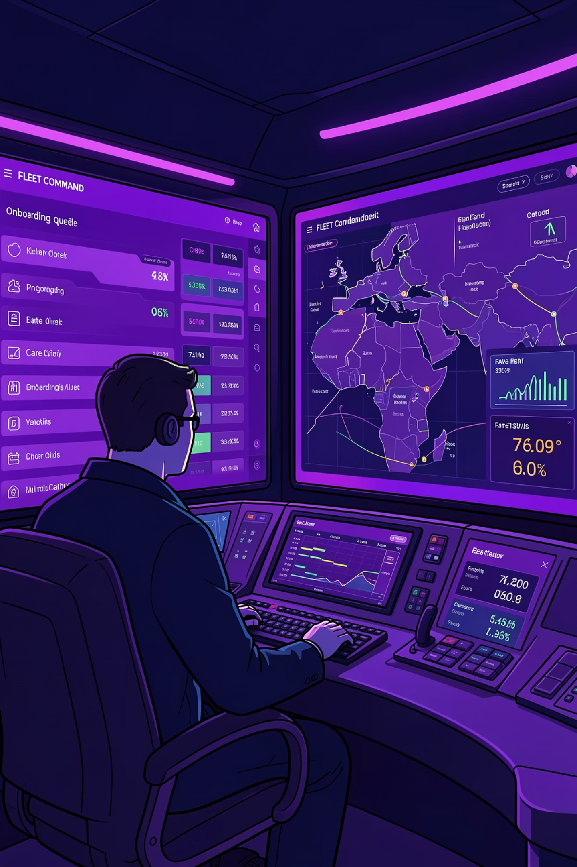




Operational Impact
Efficiency Gains
Centralized driver onboarding reduces manual steps and average approval time; automated fare calculation reduces billing errors.
Customer Experience
"Titanium" UI and verified drivers increase trust and repeat usage, improving NPS and retention.
Process Automation
State tracking and event hooks enable automated receipts, SLA notifications, and operational alerts.
Administrative Control
Real‑time oversight from a single command center: approvals, incident handling, and performance monitoring.

Slide 9
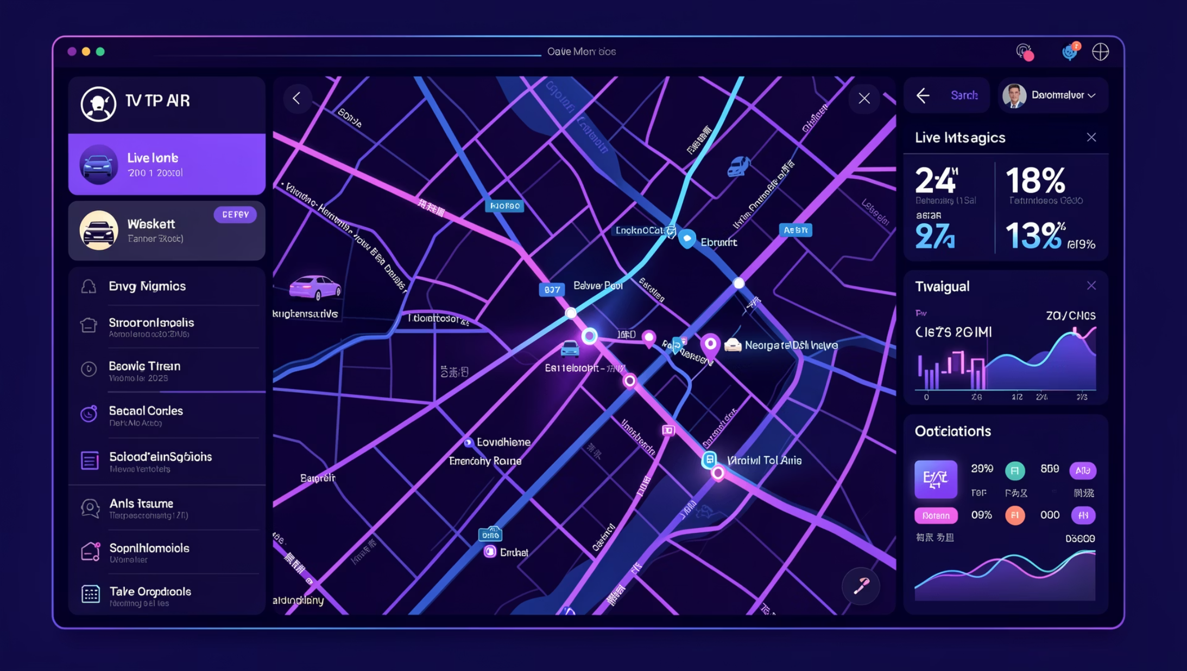
Conclusion & Next Steps
Immediate next steps: integrate Map APIs for live tracking, implement analytics pipelines for operational insights.
Approval needs: security audit sign‑off, data verification logic acceptance, and resource allocation for SRE and analytics.
Resource plan: assign long‑term maintenance owners, roadmap for scaling features (dynamic pricing, ML routing).
Kickoff: move into final execution with live fleet data and phased beta release to pilot partners.

